Slide 1
Unit 2
GCF’s and LCM’s
Algebra 1

Slide 2
Greatest Common Factor
GCF
  As small as or smaller than the smallest number given in the question
  You can list all of the factors and find the biggest one they have in common
  Take all the variables they have in common to the SMALLEST exponent given in the question

Slide 3

Ex. 1)
GCF for Variables
Take variable only if they both have it in common
Take the Smallest Exponent

Slide 4


Ex. 2)
GCF for Variables
Take variable only if they both have it in common
Take the Smallest Exponent

Slide 5

Ex. 3)
GCF for Variables
Take variable only if they both have it in common
Take the Smallest Exponent

Slide 6

Ex. 4)
GCF for Variables
Take variable only if they both have it in common
Take the Smallest Exponent

Slide 7


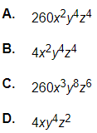
Ex. 5)
Ex. 6)

Slide 8
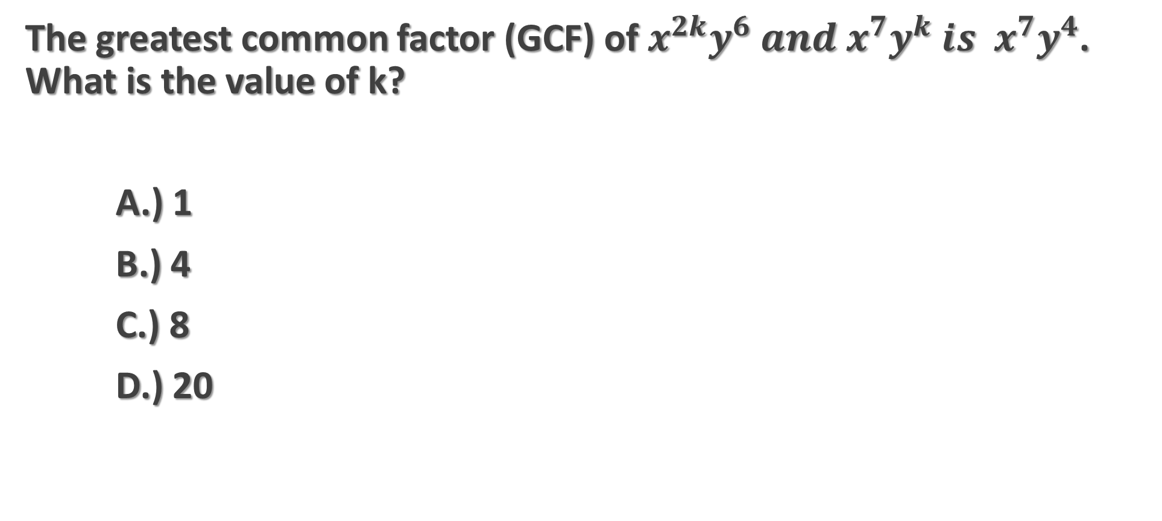
Ex. 7)
The greatest common factor (GCF) of $x^{2k}y^{6} and x^{7}y^{k}{ is x}^{7}y^{4}$. What is the value of k?
A.) 1
B.) 4
C.) 8
D.) 20

Slide 9
Least Common Multiple
LCM
  This number is as big as or bigger than the biggest number given in the question
  You can multiply the numbers and finding the smallest one they have in common
  Take all of the variables to the BIGGEST exponent

Slide 10
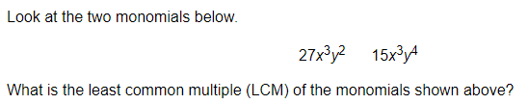
Ex. 8)
LCM for Variables
Take Variables
Take the Biggest Exponent

Slide 11
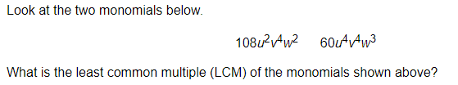
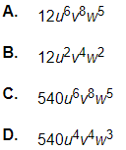
Ex. 9)
LCM for Variables
Take Variables
Take the Biggest Exponent

Slide 12
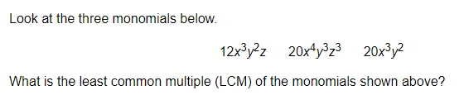
Ex. 10)
LCM for Variables
Take Variables
Take the Biggest Exponent

Slide 13
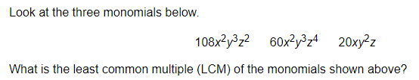
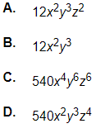
Ex. 11)
LCM for Variables
Take Variables
Take the Biggest Exponent

